Slide 1

VoyagEase Voyages Made Easy
FINAL PRESENTATION ON BUSINESS STUDY VENTURE
Group 1
STRATEGIC MANAGEMENT
JAN-MAY 2017
IISc BANGALORE
By: Under the guidance of ANANDA HARUGERI Prof. Parameshwar P. IYER
REDDY NAGA VISHWAS Department of Management Studies
SWARUP BOSE IISc, Bangalore

Slide 2
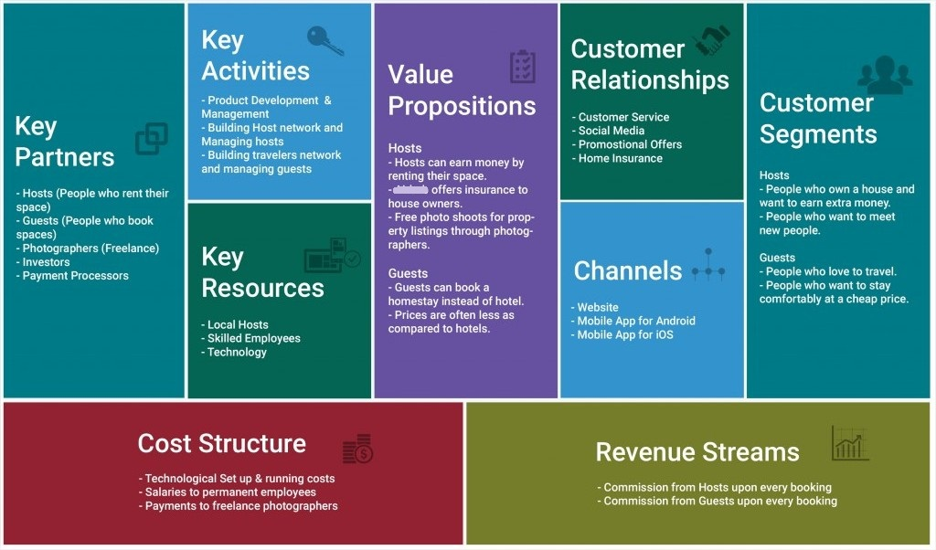

Slide 3
What is VoyagEase?
VoyagEase is online portal with one simple and focused goal to make travelling easy and a destinations best experiences available at one simple click.
How we plan to achieve it?
Creating an online market place for those who have adequate space to rent & earn an extra living and make available to those who want to explore new places in a unique way( not traditional travel)attended by local hosts. It’s lot more flexible and affordable
When?
Tourism in India is economically important and is growing rapidly. The World Travel & Tourism Council calculated that tourism generated ₹8.31 lakh crore (US$120 billion) or 6.3% of the nation's GDP in 2015 and supported 37.315 million jobs, 8.7% of its total employment.
The sector is predicted to grow at an average annual rate of 7.5% to ₹18.36 lakh crore (US$270 billion) by 2025 (7.2% of GDP).
With such high demand, the prices of accommodation becoming high there is an opportunity and huge market to attract. Our model will be the right solution for the current and future need.

Slide 4
Why?
We saw
A PROBLEM
A SOLUTION to the problem
A CUSTOMER willing to pay for the solution
Problem – CUSTOMER SIDE –
When a person is travelling He/She needs an accommodation, the cost of accommodation varies from place to place and season to season which becomes one the biggest reason for a person to avoid or make adjustments in the vacation plans. The travelers either spends high amount for the hotel in the prime area or spends more amount on the travel from his hotel to the vacation destinations.
Accommodation took up 36 % of tourism expenditure, while transport accounted for 32 % and miscellaneous other costs for 32 %
PROBLEM -MARKET SIDE
It is expected that the hotels industry is expected to fall short of meeting the long term demands of an economy growing at 7-9% p.a. Regarding the supply from foreign nations, around 40 international brands are said to enter the country in the next five years (as per Cygnus estimates).
At present, 1 in every 11 people worldwide are employed by the tourism sector, with the industry generating US$ 7.2 trillion or 9.8% of the global GDP in 2015.
India currently has over 200,000 hotel rooms spread across hotel categories and guest-houses and is still facing a shortfall of over 100,000 rooms (source: FHRAI).

Slide 5
Hotel category | No. of Hotels | No. of Rooms
5 star deluxe/5 star | 165 | 43, 965
4 Star | 134 | 20, 770
3 Star | 505 | 30,100
2 Star | 495 | 22,950
1 Star | 260 | 10,900
Heritage | 70 | 4,200
Uncategorised | 7,078 | -
Total | 8,707 | 1,32,885
Restaurants | 12,750
Dorm bed: ₹400-600
Double hotel room: ₹1500–5000
Deluxe hotel room: ₹5000–22,000
All the charges excluding food and tax services.

Slide 6

Our Solution :How it works?
Through information technologies, especially Web 2.0, mobile technology and social media, Time Sharing: A hybrid form of ownership. A time share is the right to occupy a unit of real estate property, such as a condominium or vacation home, during a specified number of separate time periods. Each time period is for a certain duration, such as one or two weeks. Time-sharing allows multiple purchasers to buy interests in the same real estate
In our Business Study Venture, we use this concept as an online marketplace and homestay network enabling people to list or rent short-term lodging in residential properties, with the cost of such accommodation set by the property owner. The company receives percentage service fees from both guests and hosts in conjunction with every booking.

Slide 7
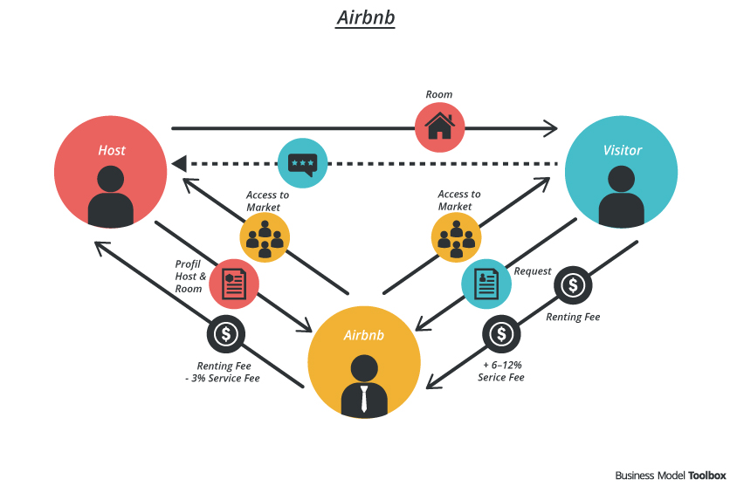
VoyagEase
VoyagEase

Slide 8
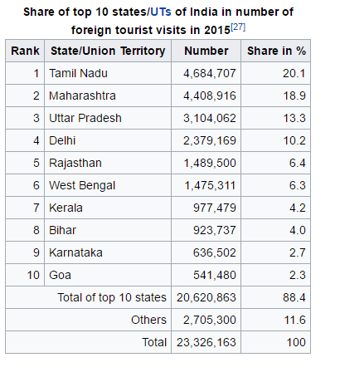
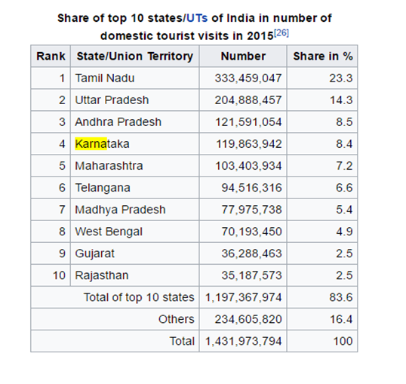
Who are our customers?

Slide 9
Our Customer and the Market Size
Tourism in India is economically important and is growing rapidly. The World Travel & Tourism Council calculated that tourism generated ₹8.31 lakh crore (US$120 billion) or 6.3% of the nation's GDP in 2015 and supported 37.315 million jobs, 8.7% of its total employment.
The sector is predicted to grow at an average annual rate of 7.5% to ₹18.36 lakh crore (US$270 billion) by 2025 (7.2% of GDP).
In October 2015, India's medical tourism sector was estimated to be worth US$3 billion. It is projected to grow to $7–8 billion by 2020. In 2014, 184,298 foreign patients traveled to India to seek medical treatment. About 88.90 lakh (8.89 million) foreign tourists arrived in India in 2016 compared to 80.27 lakh (8.027 million) in 2015, recording a growth of 10.7%.
Domestic tourist visits to all states and Union Territories numbered 1,036.35 million in 2012, an increase of 16.5% from 2011.
the sharing economy, represented a global market worth 15 billion dollars, in 2014; 29 billion dollars, in 2015; and are expected to reach 335 billion dollars, by 2025.

Slide 10
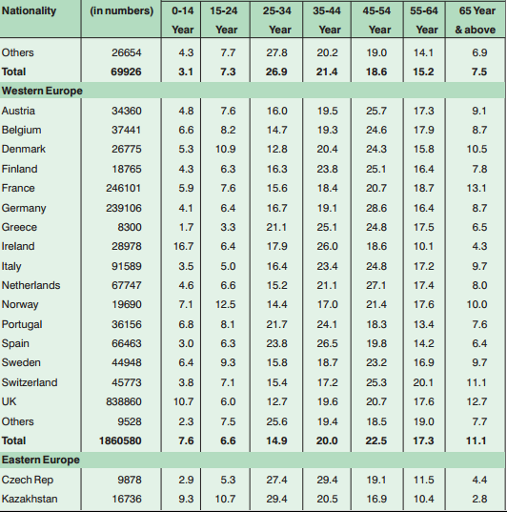
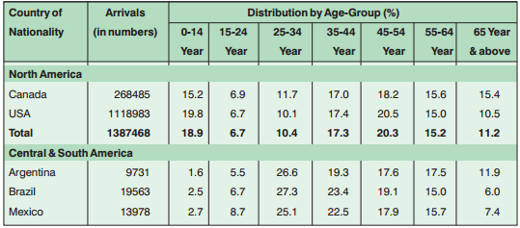
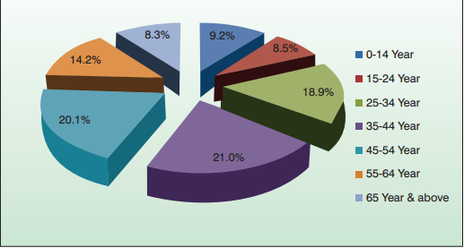
Specifics
In 2015, Indian travelers were from 35-44 years age group (21%), followed by the age groups of 45-54 years (20.1%) and 25-34 years (18.9%). The lowest number during the same period occurred in the age-group of 65 & above (8.3%).
When we spoke to our customers who are ready for this service we found the average user being 62% are male, with an average age of 32.5 years.

Slide 11
Why We need Strategic Management?
Our BSV, VoyagEase, needs strategic management as under strategic planning, the first step is to set the goals or objectives of a business concern. Strategic decisions are taken under strategic management help the smooth sailing of an enterprise. The major areas where we need Strategic Management for our BSV is
(a) Marketing opportunity: Products, prices, sales potential and sales promotion.
- Since our product is Time Sharing and in India if we do not market our product and make people aware of it then we will never attract the owner and consumer.
- Pricing right is one of our major concern as the competition in the market to provide the service competitive rates than the Hotels and the other Time Sharing competitors of the market
(b) Available distribution channel and costs.
Distribution Channel
1> The product is a service platform and doesn’t involve any physical logistics related to services.
2>-However the distribution is required to capture the customer base both in the view point of host and visitor.
3>An ideal platform for distribution to operate the product is through internet portal via the website and mobile applications

Slide 12
Initial Investment | Approximate Cost
Information Technology Platform | 50 lakhs
Human Resource | 15 people = 75 lakhs
Marketing and Sales | 50 lakhs
Office and Furnishing | 25 lakhs
Establishment | Legal:10lakh Intellectual Property: 10Lakh
Costs
1> Initial Investment
2> Running Cost
Running Cost | Approximate Cost P.A
IT Operations | 10 Lakhs
HR Operations | 20 Lakhs
Marketing and Sales Operations | 50 lakhs (Incentive & promotions, tie ups )
Host Management Cost | 50 lakhs
*All costs are in INR.

Slide 13
c)The scale of company operations.
- The initial focus of operations would be top 10 tourist destination states within India catering the needs of the domestic and international customer. Currently, there are 143 crores of domestic and 2.3 crores of International tourist visits in these top 10 states of India. Considering this the scale of operations is expected to cover more than 140 crores travel visits every year in India.
(d) The planned rate of growth.
Considering the year on year growth rate about 10 % in the tourism sector in India, the company also expects to grow at this rate and plans to expand to the international market.
Considering the above aspects of this initiation the strategic management approach is required for initial establishment and effective operations.

Slide 14
Vision & Mission- VoyagEase
Vision Statement
To build a world class community-driven hospitality company that makes voyagers feel like they belong to anywhere.
Mission Statement
Create a customer focused platform where voyagers can belong anywhere and can live in a place, instead of just travelling to it.
Offer hospitality at competitive price where both host and voyager at benefited.
Facilitate cross-cultural exchanges by providing voyagers with a safe place to call home and an insider experience of local life

Slide 15
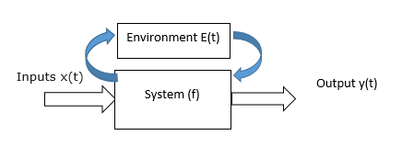
System Inputs:
No. of Personnel to be housed in a location need to be finalized based on which the accommodation requirements at specified location shall be freezed.
2. Project Finance: Sufficient availability of funds to complete the project in the specified period
System Outputs:
An online marketplace and homestay network enabling people to list or rent short-term lodging in residential properties, with the cost of such accommodation set by the property owner. The company receives percentage service fees from both guests and hosts in conjunction with every booking.
System Parameters:
The system parameters are the components of the system
Locations / Availability of the Homes
Design development and Approvals
Cost Estimates
Project Finance
Web and Mobile Applications Development
Third Party Inspection
Payments & Certifications
Regulatory approvals and
Maintenance

Slide 16
Environmental Parameters
Political Stability
Funding
Availability of host at all required locations.
Availability of Supervisory personnel.
Server and Software malfunctions
Cyber-attack on the website or database
Opposition by cultural groups in locations wherein cultural impact is significant.
Force Majeure in case of natural disasters such as earthquakes, floods and landslides.

Slide 17
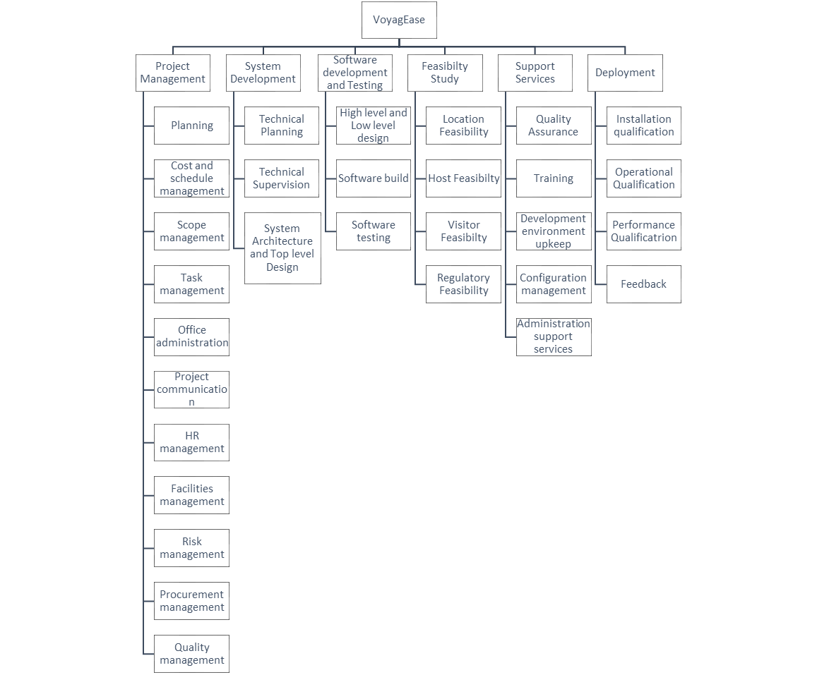
WORK-BREAKDOWN STRUCTURE

Slide 19
Market Research of Our BSV :
Outcomes of discussions with host:
Towards this task, the team engaged discussions with about 30 hosts in various categories. The host raised initial concerns regarding the payment modality, security and the related agreements.
The payment modality concerns associated with post were clarified by informing them that the payment would be made up front at the beginning of the contract.
The security concerns associated with the host were taken care by ensuring that them off the standard insurance process and by verification of the background of the visitors.
The hosts was informed that the agreements will be considering local regulations and related requirements. The host were also explained regarding the cancellation policy its associated payments and prioritization of their premises during the next opportunity so that their association with this business venture is valued.
Outcomes of the discussions with visitors:
The team discussed regarding this business venture with 15 potential visitors. Visitors were interested in knowing the available options, related cost, cancellation policy, security and the differentiated services.
The visitors were informed of the available options from the venture like paying guests, hostels, homestays, hotels, dormitories and long stay homes.
The visitors were assured of the competitive cost offered by this business venture. During the discussions, the visitors were happy to hear that no cancellation fee would be applied if they do not occupy the host promises per their plan.
Considering the security concerns raised by the visitors they were educated regarding the various insurance policies that they can opt during their stay and also they were assured of the background verification process of hosts. The key services offered by VoyagEase were explained and highlighted to visitors with the comparing the key features of the competition and the benefits of this business venture.

Slide 20
Outcomes of the discussion with the team:
The team engaged two brainstorming sessions regarding the business venture.
The team raised issues regarding fraud hosts and visitors, capital investment, indemnity, scope of services, and standards for background verification.
The team also narrowed down from various solutions to realistically adoptable aspects like, fire wall for the technology platform, investment through venture capitalists, focused services towards Indian hosts and tourists, and background verification adopting the Aadhar and passport photo identity proofs with blacklist of fraudsters

Slide 21
External Factor Evaluation:
Factor |  | Weightage | Rank | Weighted Score
Opportunity
1 | Tourists | 0.10 | 4 | 0.4
2 | Hosts offering their premises | 0.05 | 2 | 0.1
3 | Political stability | 0.04 | 1 | 0.04
4 | Start-up India promotion by government | 0.08 | 4 | 0.32
5 | Tourism development | 0.08 | 4 | 0.32
6 | Increasing internet users for booking stay | 0.07 | 4 | 0.28
7 | Social media | 0.08 | 3 | 0.24
Threat
8 | Competition | 0.11 | 2 | 0.22
9 | Security | 0.05 | 1 | 0.05
10 | Quality perception | 0.06 | 2 | 0.12
11 | Cyber attack | 0.07 | 2 | 0.14
12 | Seasonal variation | 0.05 | 1 | 0.05
13 | Infrastructure development | 0.06 | 2 | 0.12
14 | Legal environment | 0.03 | 1 | 0.03
15 | Social media | 0.07 | 3 | 0.21
 | Total | 1.00 |  | 2.64
VoyagEase scores 2.64 in EFE matrix which is above than standard score of 2.5. We would be working towards aspiring for a better score. Venture needs to take opportunity of the market potential as well as work towards security, seasonal variation and legal environment.

Slide 22
Internal Factor Evaluation
Factor | Weightage | Rank | Weighted Score
Strengths
Strong technical & financial promoters | 0.20 | 4 | 0.80
Unique service | 0.25 | 3 | 0.75
Networking of the promoters | 0.20 | 2 | 0.40
Weakness
Yet to be funded | 0.20 | 2 | 0.40
First venture of promoters | 0.15 | 2 | 0.30
Total | 1.00 |  | 2.65
VoyagEase scores 2.65 in IFE matrix which is little above to standard score of 2.5 . We would be working towards creating a niche in the market and productize our service offering as well as attract investors to improve our internal strength.

Slide 23
Strategies
Tools Used for Strategy Formulation : TOWS, Internal External Matrix, SPACE Matrix and BCG Matrix
Outcome: Internal External Matrix Suggest that VOYAGEASE is Aggressive or can be categorized under the STARS in the BCG Matrix. Hence we can grow and build the ‘Strengths-Opportunities (SO)’ strategy for VOYAGEASE
Build a user friendly web and mobile application based platform linked with Social Media.
Quickly Capture majority of Local Hosts and Guests by giving incentive of NO VOYAGEASE charges on the first two transactions and referral bonuses.
Integration of Tours and Travel Service providers, Credit Service providers , Tourist spots & Shopping Centers, and Local restaurants.
Aggressive market penetration through offers for Large Local and Social Communities, College and University Students , Sales and Marketing Organizations and Loyalty Rewards.
Value addition to the product through continuous improvement of the platform based on customer feedback and needs.

Slide 24
Strategy Selection: Quantitative Strategic Planning Matrix

Slide 25
Challenges in Strategy implementation
Management issues:
Annual Objectives by directly involving all managers
Constant communication
Resources Allocation:
Financial – Initially to build platform, aggressive marketing and further value addition
Human – 50% Sales and Marketing, 20% Customer Support, 15% Technology Service, 10% Administrative and 5% Management
Technological upkeep – Constant innovation
Physical – Operate with limited physical assets and allocation to only staff in need.
Conflicts Management:
Standard policies
Avoidance/Diffusion/Confrontation
Organizational Structure:
New Strategy
New Administrative Problems
Organization Performance
Declines
New Organizational Structure
Organization Performance Improves

Slide 26


